Slide 1
Y
L
Y
L
H
H
Y
L
H

Slide 2






YoungHun Lee
Full Stack Developer

Slide 3
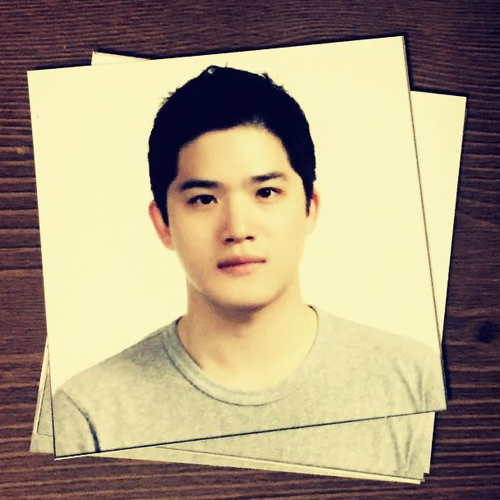

Slide 4




Slide 5
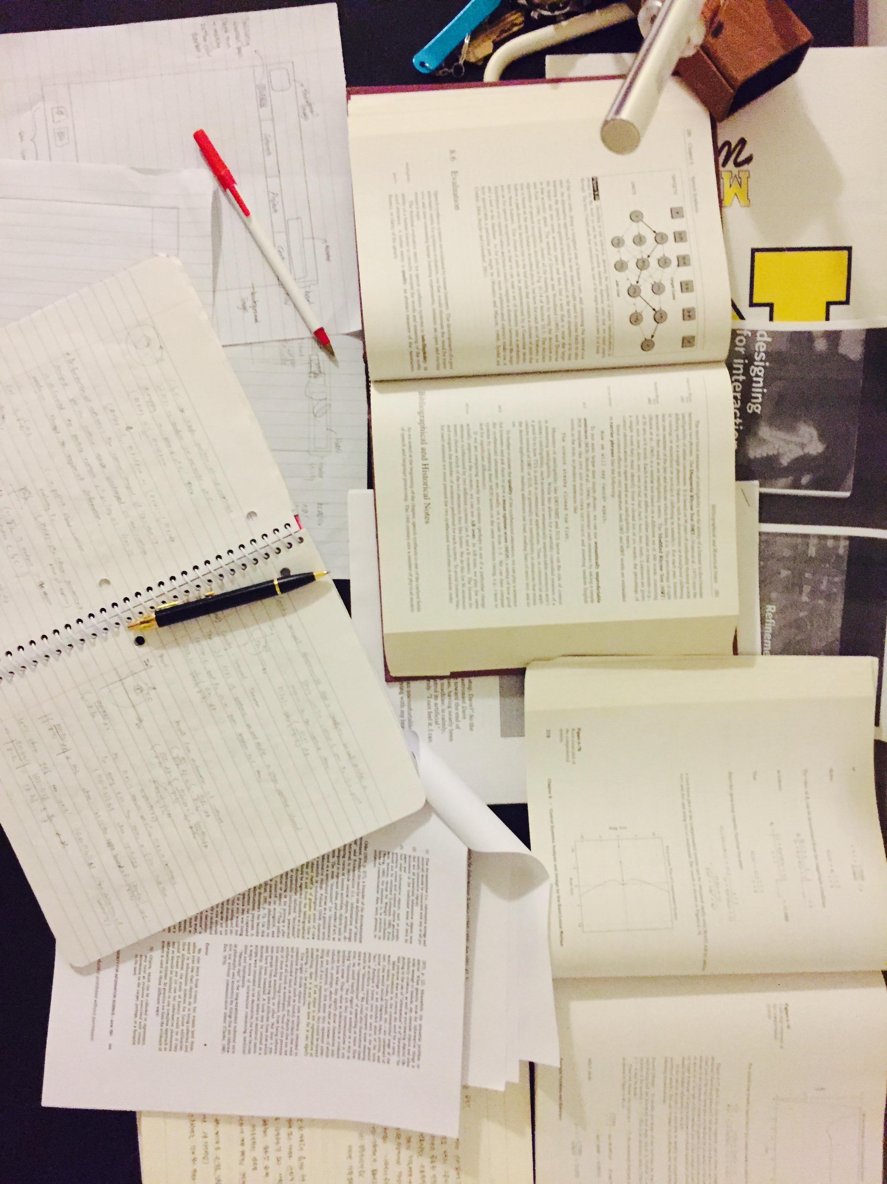

Slide 6
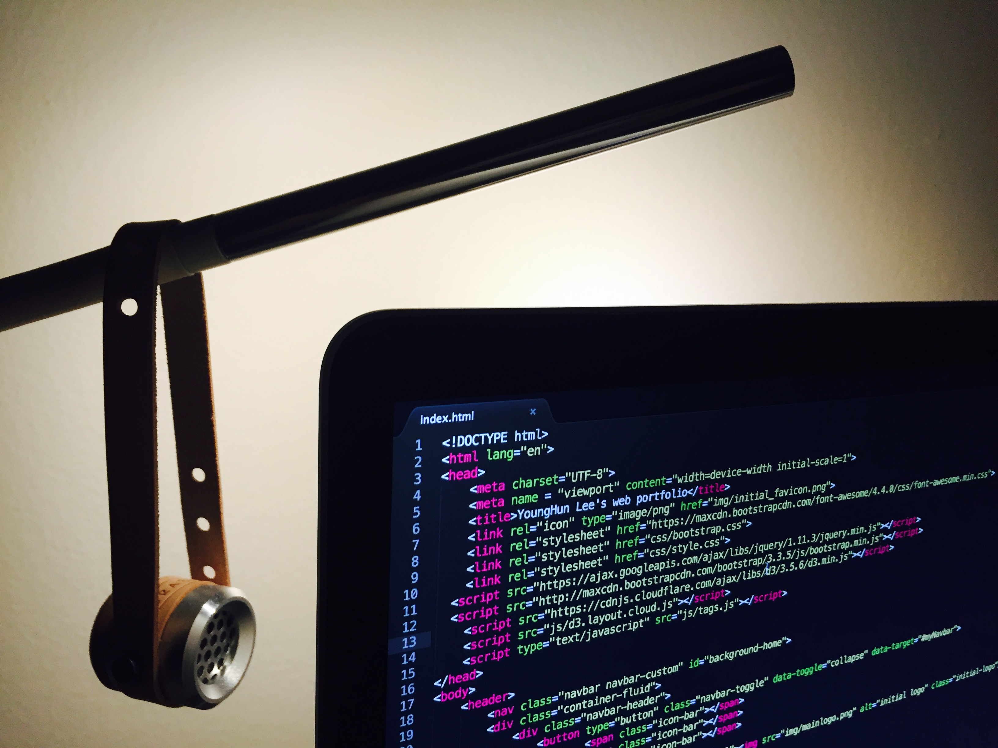

Slide 7





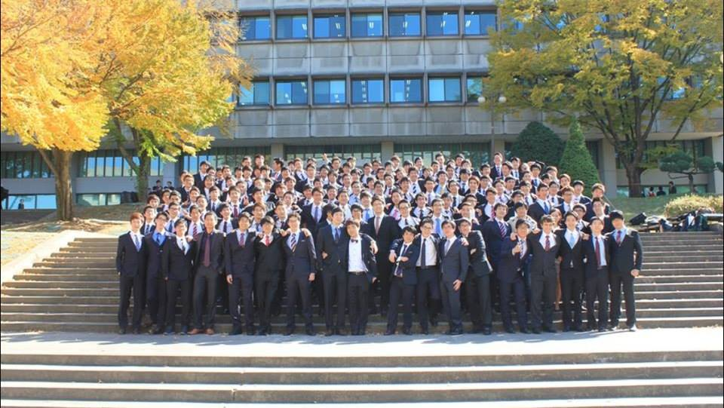






Slide 8


Slide 9


Slide 10






